Slide 1


Introduction to Python – Week 6
Mark Smith

Slide 2
Course outline
Lesson 1 – Getting Started: Introduction and Arithmetic Operators
Lesson 2 – Types and Variables
Lesson 3 – Functions
Lesson 4 – Conditional Statements
Lesson 5 – Further Conditionals and Recursion
Lesson 6 – Functions with Return Values
Lesson 7 – Lists
Lesson 8 – Dictionaries
Lesson 9 – Tuples
Lesson 10 – Project

Slide 3
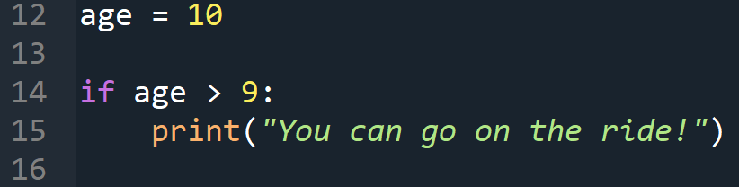
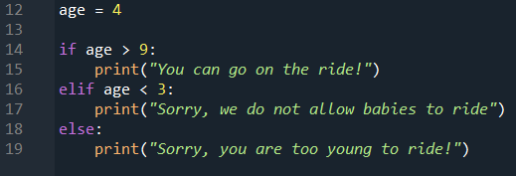
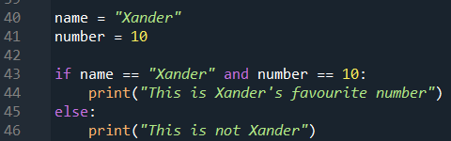
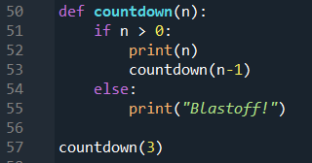
Last Week
What are alternative conditionals?
What are chained conditionals?
What are nested conditionals?
What are recursive functions?

Slide 4
This Week – Functions with return values
Today we will learn:
What are functions with return values?
Why do we use functions with return values?
What are Boolean functions?
Some more recursive functions

Slide 5
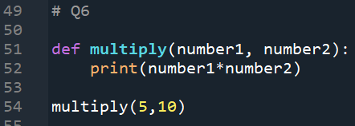
functions
The functions we have written are all void functions
We want to write functions that we can use in other parts of our program. What do we need?
A return value!

Slide 6
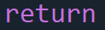
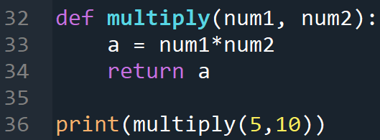
Return value
A return value is like a print statement and allow us to use the function in other programs and functions. We use the keyword

Slide 7
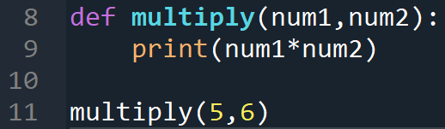
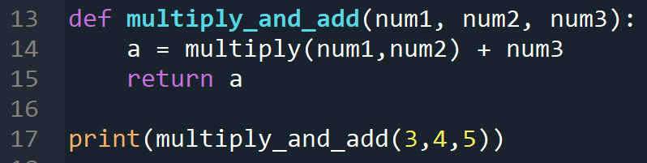
Why use return values?
Recall the multiply function
Say we want a new function, multiply_and_add
What happens when we run line 17?

Slide 8
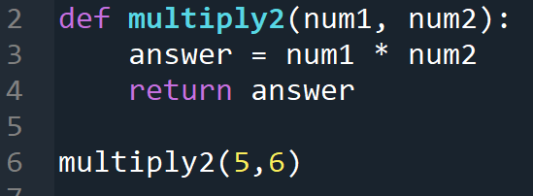

Why use return values?
We fix this by using a return value
Now we can run our new function, multiply_and_add
What happens when we run line 17?

Slide 9
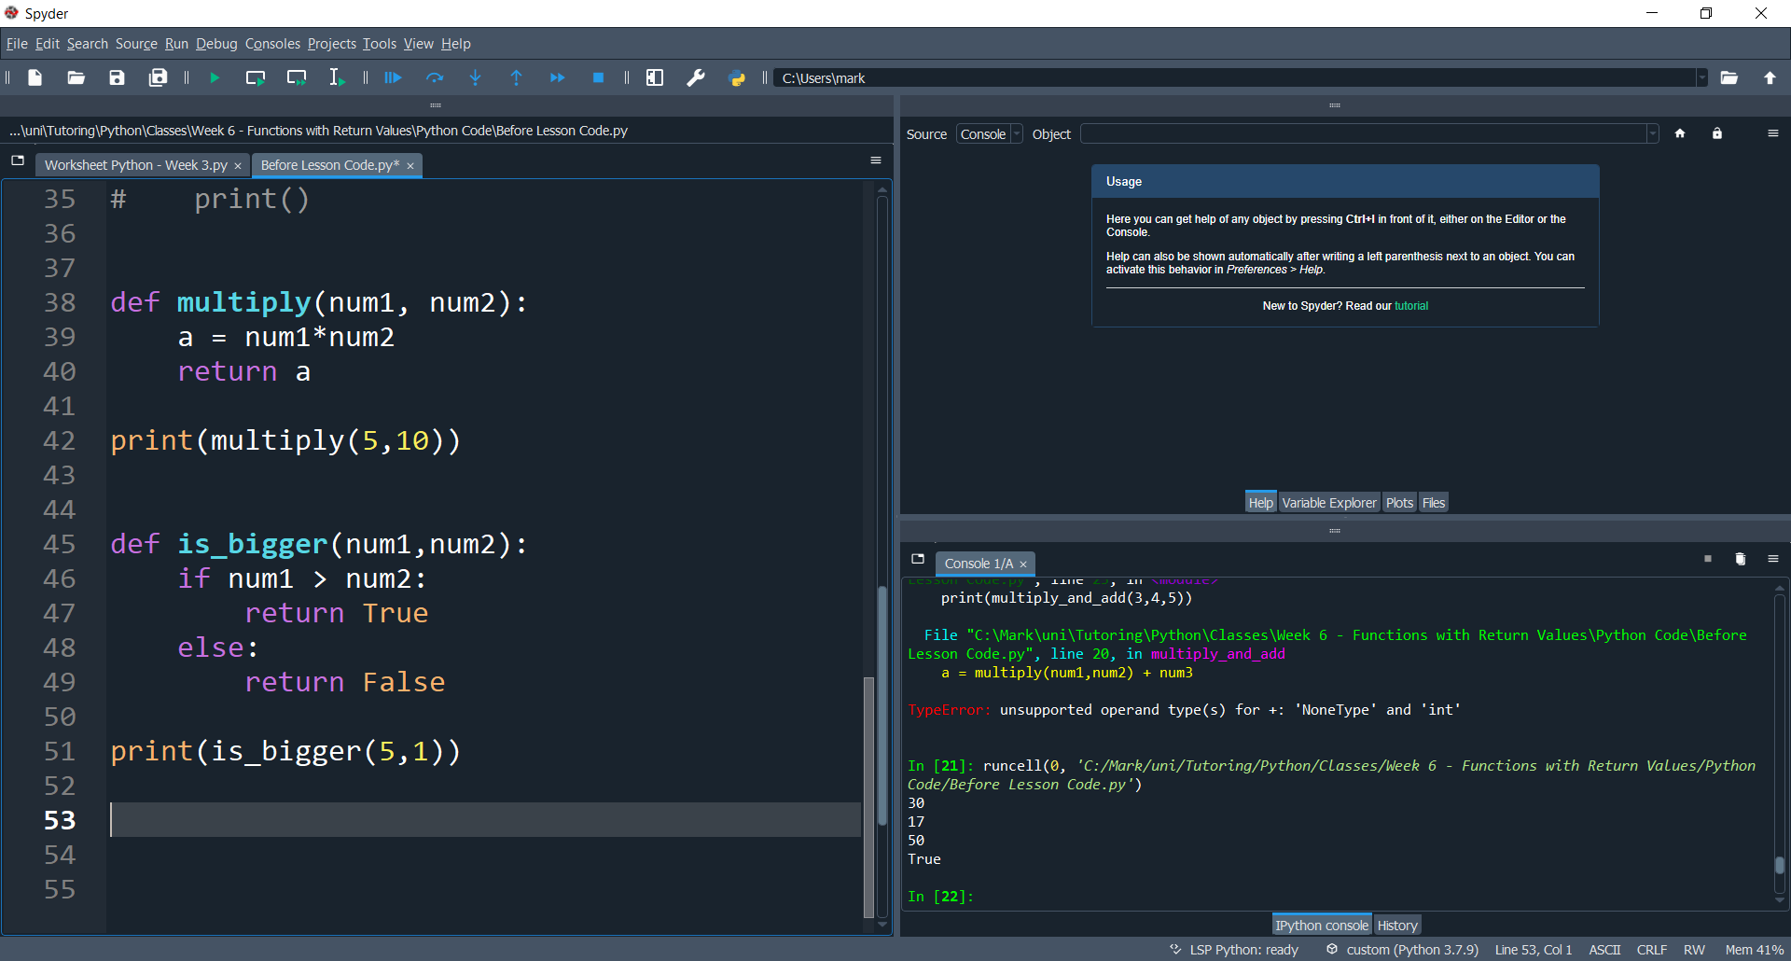
Boolean functions
We can also write functions that return Boolean values, this is useful to write functions that check something

Slide 10
End of class
This week we have looked at:
What are Relational Operators
What are Conditional Operators
How do we use Conditional statements

